Slide 1
Modeling Effects of Enrollee Choice
Edilawit Gebreselassie
October 2021

Slide 2
Overview
The health insurance marketplace provides a range of available plans customers can choose from depending on their healthcare needs.
Customers can make their decisions based on:
Estimated healthcare needs
Out-of-Pocket costs such as deductibles, copays and co-insurance
The study presents the effect of customer insurance plan selection on medical loss ratios and insurer profitability.

Slide 3
Overview
Increased choice will lead to increased insurance expense due to:
Customers’ need to minimize out of pocket costs
Customers’ anticipated healthcare costs
A model that simulates enrollee choice was developed to see the effect of choice on expense

Slide 4
Data Description
A sample of families from the Medical Expenditure Panel Survey (MEPS)
MEPS produces healthcare utilization and cost data along with detailed demographic information using the most current population survey.
The sample of families consisted of :
Families that participated in both the 2015 and 2016 surveys
Families that have an income level of at least 100% of the FPL

Slide 5
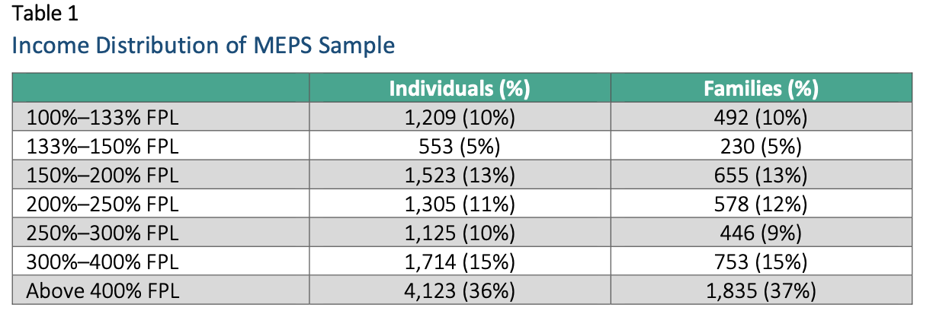
Data Description
The data used for this simulation sample includes:
4,989 families
11,552 individuals

Slide 6
Data Challenges
Underreported healthcare utilization and spending data
Data adjustment made by comparing the MEPS data with utilization and cost data produced by IBM Watson and Optum databases.
Aggregated care categories
No distinction of office visits (PCP vs. Speciality)
No distinction of prescription drugs (Brand vs. Generic)

Slide 7
Analytical Methodology
An excel based simulation model was built using the sample families
The simulation presents each family with a number of health plan options
The families’ decisions are simulated utilizing a random selection and a pre-defined set of decision rules:
The lowest premium plan,
Prior year costs determine subsequent year plan selection and (Prior year rule)
Family’s actual future year costs determine the optimal plan (Perfect foresight rule)

Slide 8
Analytical Methodology
Output measures of the simulation include:
Market-Level Medical Loss Ratio (MLR),
Percentage of times a selection turns out to be optimal and
Mean monetary difference between selection using the random choice and 2 decision rules (prior year and optimal plan)

Slide 9
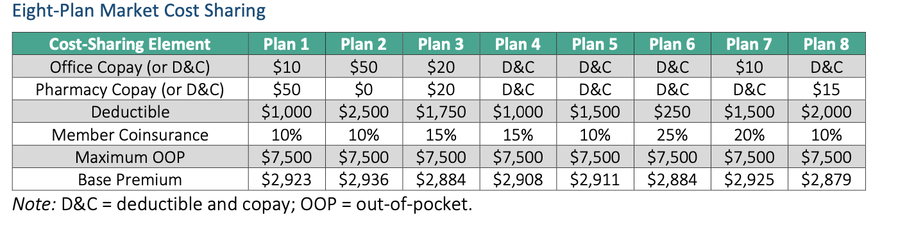
Analytical Methodology
Two Plan Market
Office Visits vs. Prescription Drugs
Eight Plan Market
Wider range of available plans

Slide 10
Results and Implications
Two Plan Market
Prior year decision rule resulted in a 0.1% increase in MLR and a $11 savings per family
Perfect oversight rule resulted in a 4.5% increase in MLR and a $357 savings per family
Eight Plan Market
Prior year decision rule resulted in a 1.9% increase in MLR and a $135 savings per family
Perfect oversight rule resulted in a 6.8% increase in MLR and a $606 savings per family

Slide 11
Results and Implications
Increased plan information will optimize customers’ selection
This will increase costs on insurers by increasing MLR
This could in return lead to increased premiums in the future

Slide 12
References
Hileman, G. (2021, January). Modeling effects of enrollee choice - member | SOA. Society Of Actuaries . Retrieved October 4, 2021, from https://www.soa.org/globalassets/assets/files/resources/research report/2021/modeling- enrollee-choice.pdf.

